Slide 1

Design an Inventory Management App
Balakrishna

Slide 2
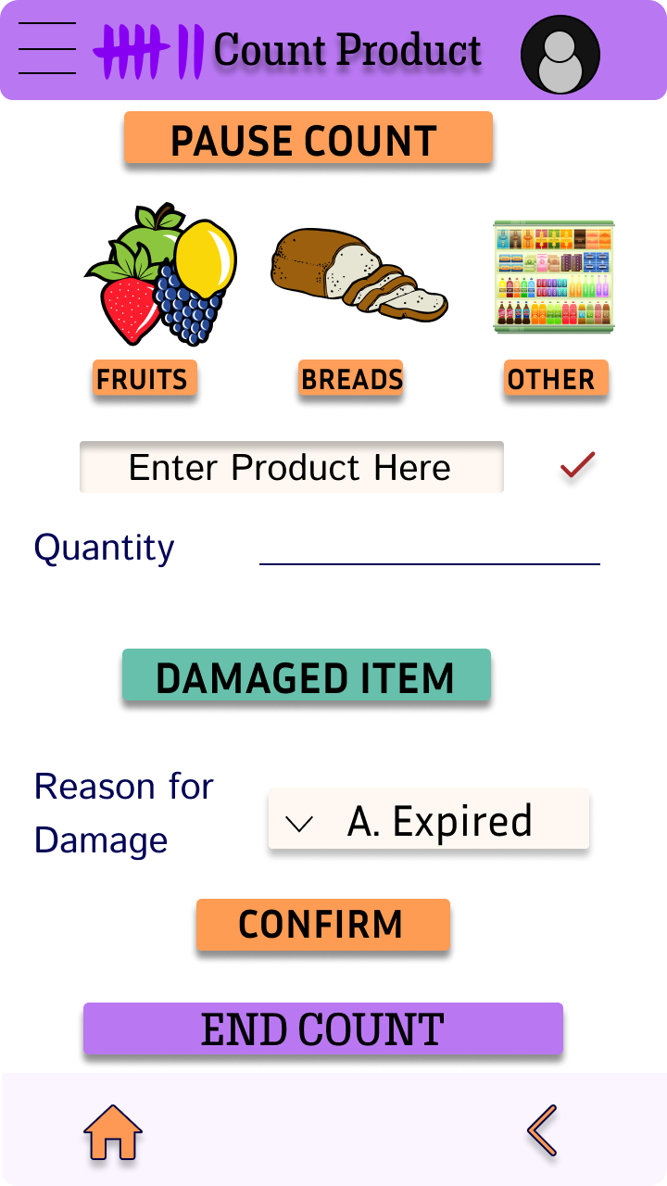
Project overview
The product:
StorePicker App is a Picking and Counting solution to help small storekeepers manage their stock more efficiently so that they can have a clear visibility of the leakages they are unable to identify in their business.
Project duration:
Jan 2022-March 2022

Slide 3
Project overview
The problem:
There are no effective options for small store users to help with their daily store stock management
The goal:
Design an Inventory Management App for a Local Store

Slide 4
Project overview
My role:
User Experience Designer handling the end to end workflow for the project in the Design Phase.
Responsibilities:
User Research and Ideation
Competitive Audit
Wireframing
Low and High Fidelity Design Prototyping
Design Iterations

Slide 5
User research
Personas
Problem statements
User journey maps
Understanding
the user

Slide 6
User research: summary
Based on the user research conducted, we have come up with a design prototype to handle the main categories which the users are facing – Store Picking and Stock Counting.
We have done a Competitive Audit to understand the strengths and weaknesses of the players in the market and designed the solution to target a niche market. The initial rounds of user research asked for more features to be included and the later rounds asked for simplification of design. To simplify the design, we made some of the functionalities optional – which the users can opt out.

Slide 7
User research: pain points
1
2
3
Lack of Solutions
Accessibility
Need for Insights
Availability of store inventory management solutions for small stores
No solutions available for non-English speakers or those who are visually challenged
A quick and crisp summary of a cyclic count is not available.

Slide 8
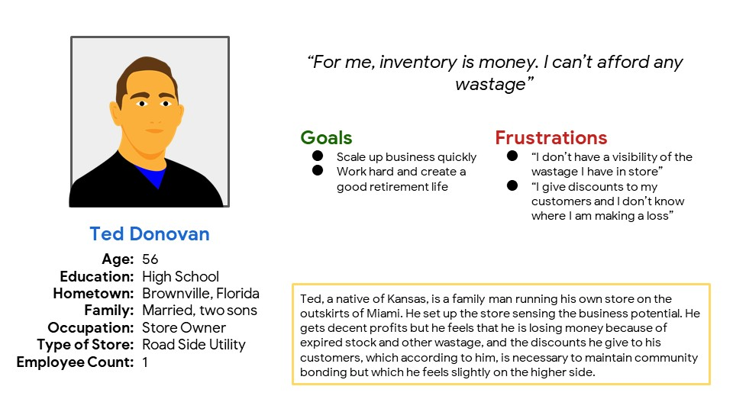
Persona: Ted Donovan
Problem statement:
Ted is a Store Owner who needs a solution to track and update the inventory in his store because it's too tedious to identify what is causing discrepancies in stock positions

Slide 9
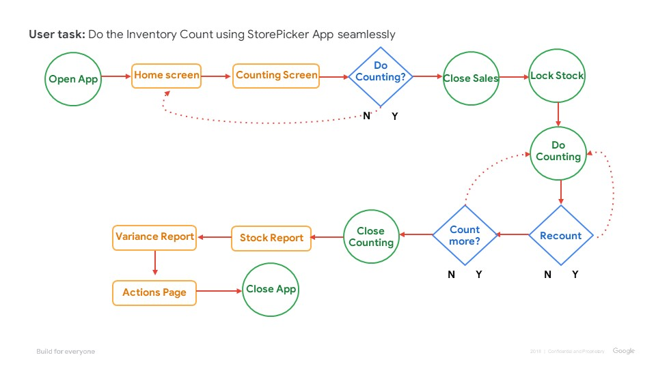
User journey map
The user journey here depicts how a user will perform the counting in the store and complete the process successfully
Image of user journey map

Slide 10
Paper wireframes
Digital wireframes
Low-fidelity prototype
Usability studies
Starting
the design

Slide 11
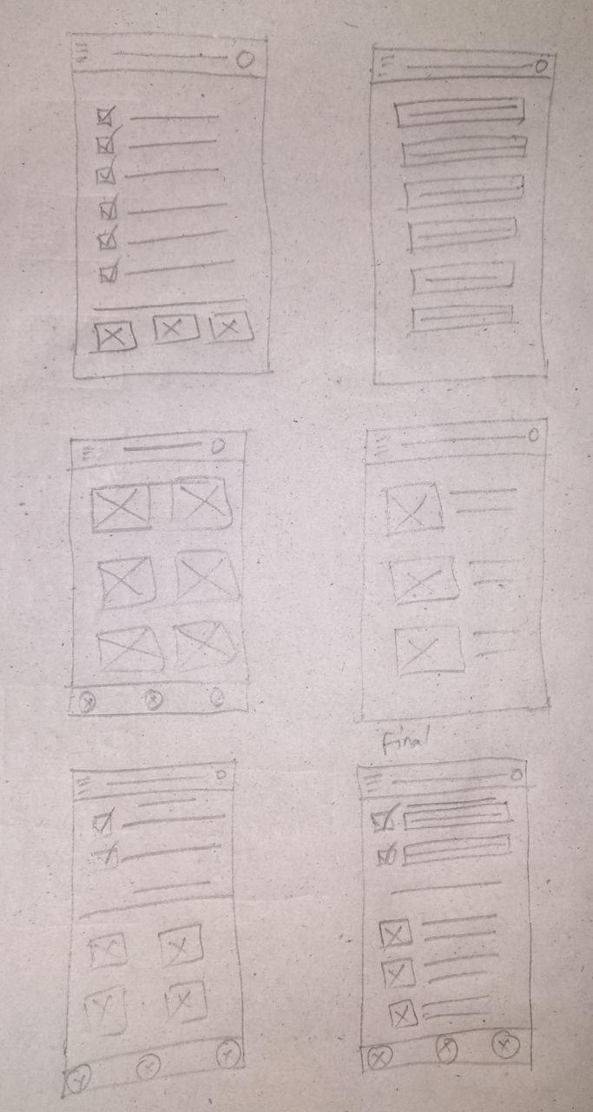
Paper wireframes
Due Diligence was done in designing the wireframes and the most appealing components out of them are considered into the final wireframe along with some changes which are not visible in the original five.
Image of paper wireframes including five different versions of the same screen and one image of the new, refined version

Slide 12
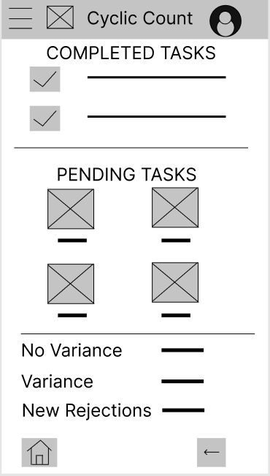
Digital wireframes
The list of completed tasks will be shifted from Pending Tasks to here
The digital wireframe follows the pattern of the paper wireframe created but with some minor changes included to enhance user experience
Insert first wireframe example that demonstrates design thinking aligned with user research
These are the open activities and this view gives a dedicated focus for the user
A summary of the count as of now

Slide 13
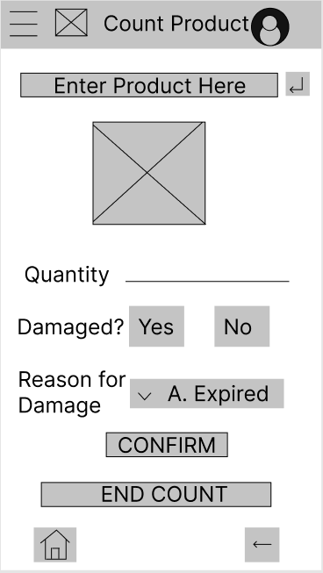
Digital wireframes
This is a follow-up of the first wireframe. This screen will be activated when the user starts to perform the action in the previous screen
The image is a visual cue for the store assistant that he is counting the correct product
Insert second wireframe example that demonstrates design thinking aligned with user research
By including damages and the reason for the damages in the same screen, the store assistant’s work is considerably reduced

Slide 14
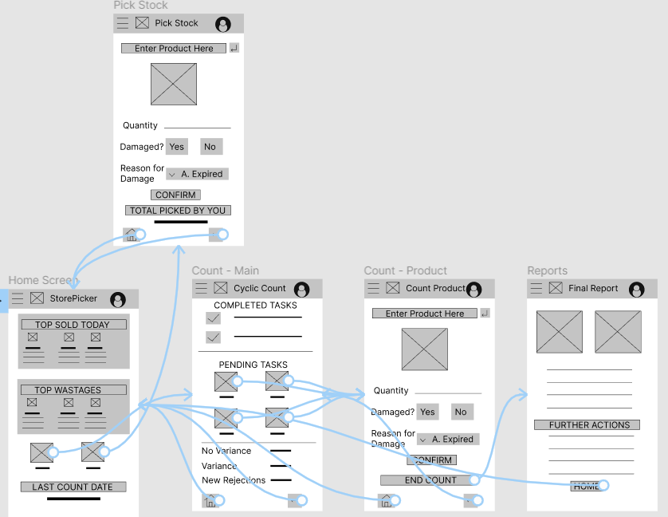
Low-fidelity prototype
The prototype, modelled on the finalized wireframe covers all possible interactions in the app and gives the user a wholesome experience
Screenshot of prototype with connections or prototype GIF

Slide 15
Usability study: findings
Write a short introduction to the usability studies you conducted and your findings.
Round 1 findings
Round 2 findings
1
Dropdown for Product Selection Needed
1
Pause Counting is Distracting
2
Option to Print Report
2
“Damaged – No” is not needed
3
Introduce Pause Counting

Slide 16
Refining
the design
Mockups
High-fidelity prototype
Accessibility

Slide 17

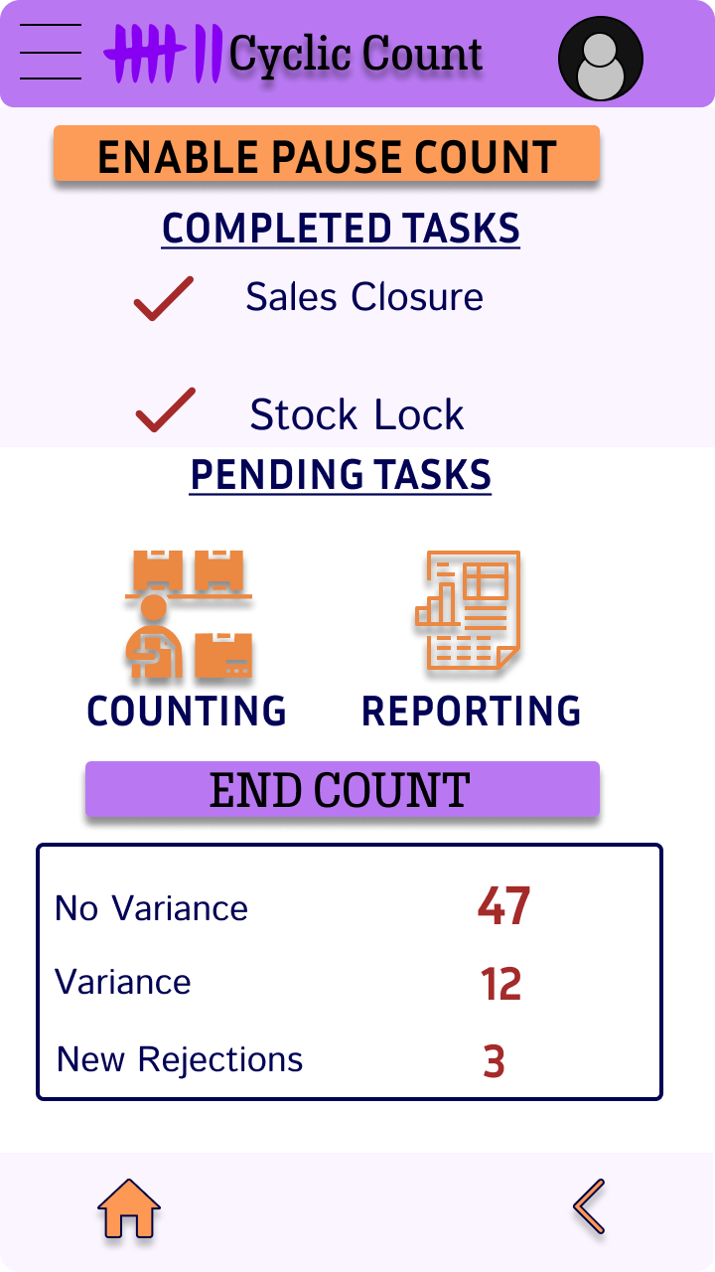
Mockups
Before usability study
After usability study
Early Designs didn’t consider the concept of Pause Count. In the later iterations, Enable Pause Count is introduced as an option for a distraction free counting experience
Image of selected screen before usability study
Image of selected screen after usability study

Slide 18
Mockups
Before usability study
After usability study
Early Designs didn’t consider the concept of Pause Count. During the first iteration, a Pause Count is enabled. During the second iteration, it’s shifted to the main screen and made optional. Also, default check for damaged item is removed
Image of selected screen before usability study
Image of selected screen after usability study

Slide 19
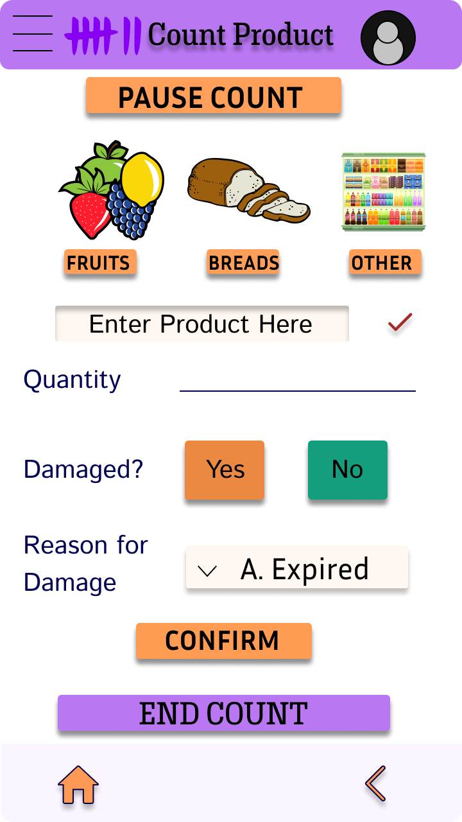
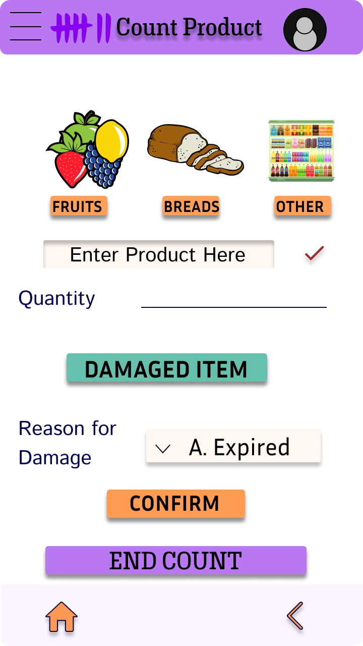
Mockups
Before usability study
After usability study
The second usability study expressed frustration with a Pause Count Option which a majority of the users didn’t use. Also, the users asked the need for having Damaged No. The first is made optional and the second is removed.
Image of selected screen before usability study
Image of selected screen after usability study

Slide 20
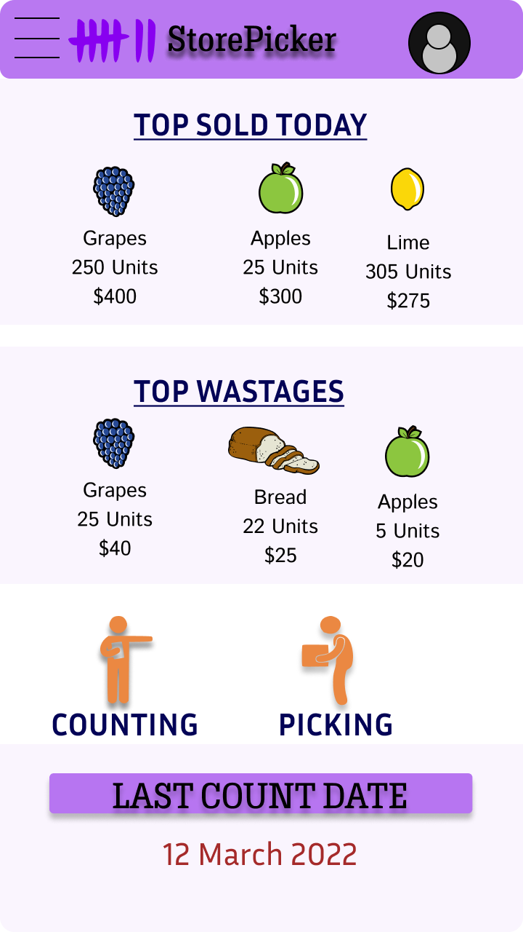
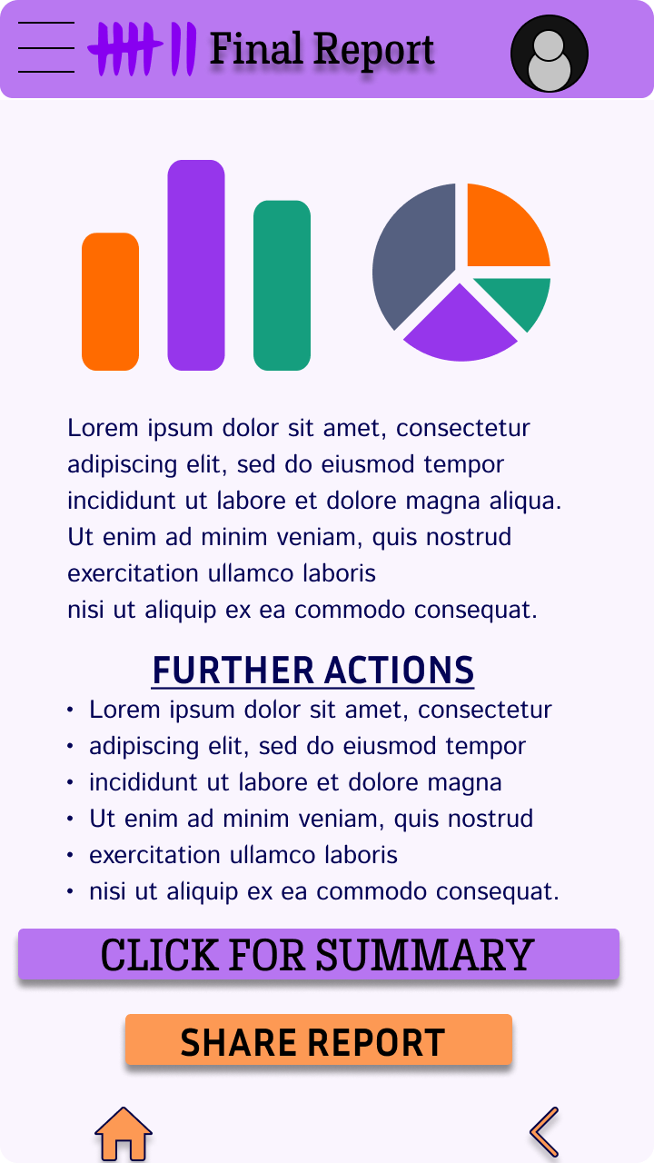
Mockups
Main mockup screen for display
Main mockup screen for display
Main mockup screen for display
Main mockup screen for display

Slide 21
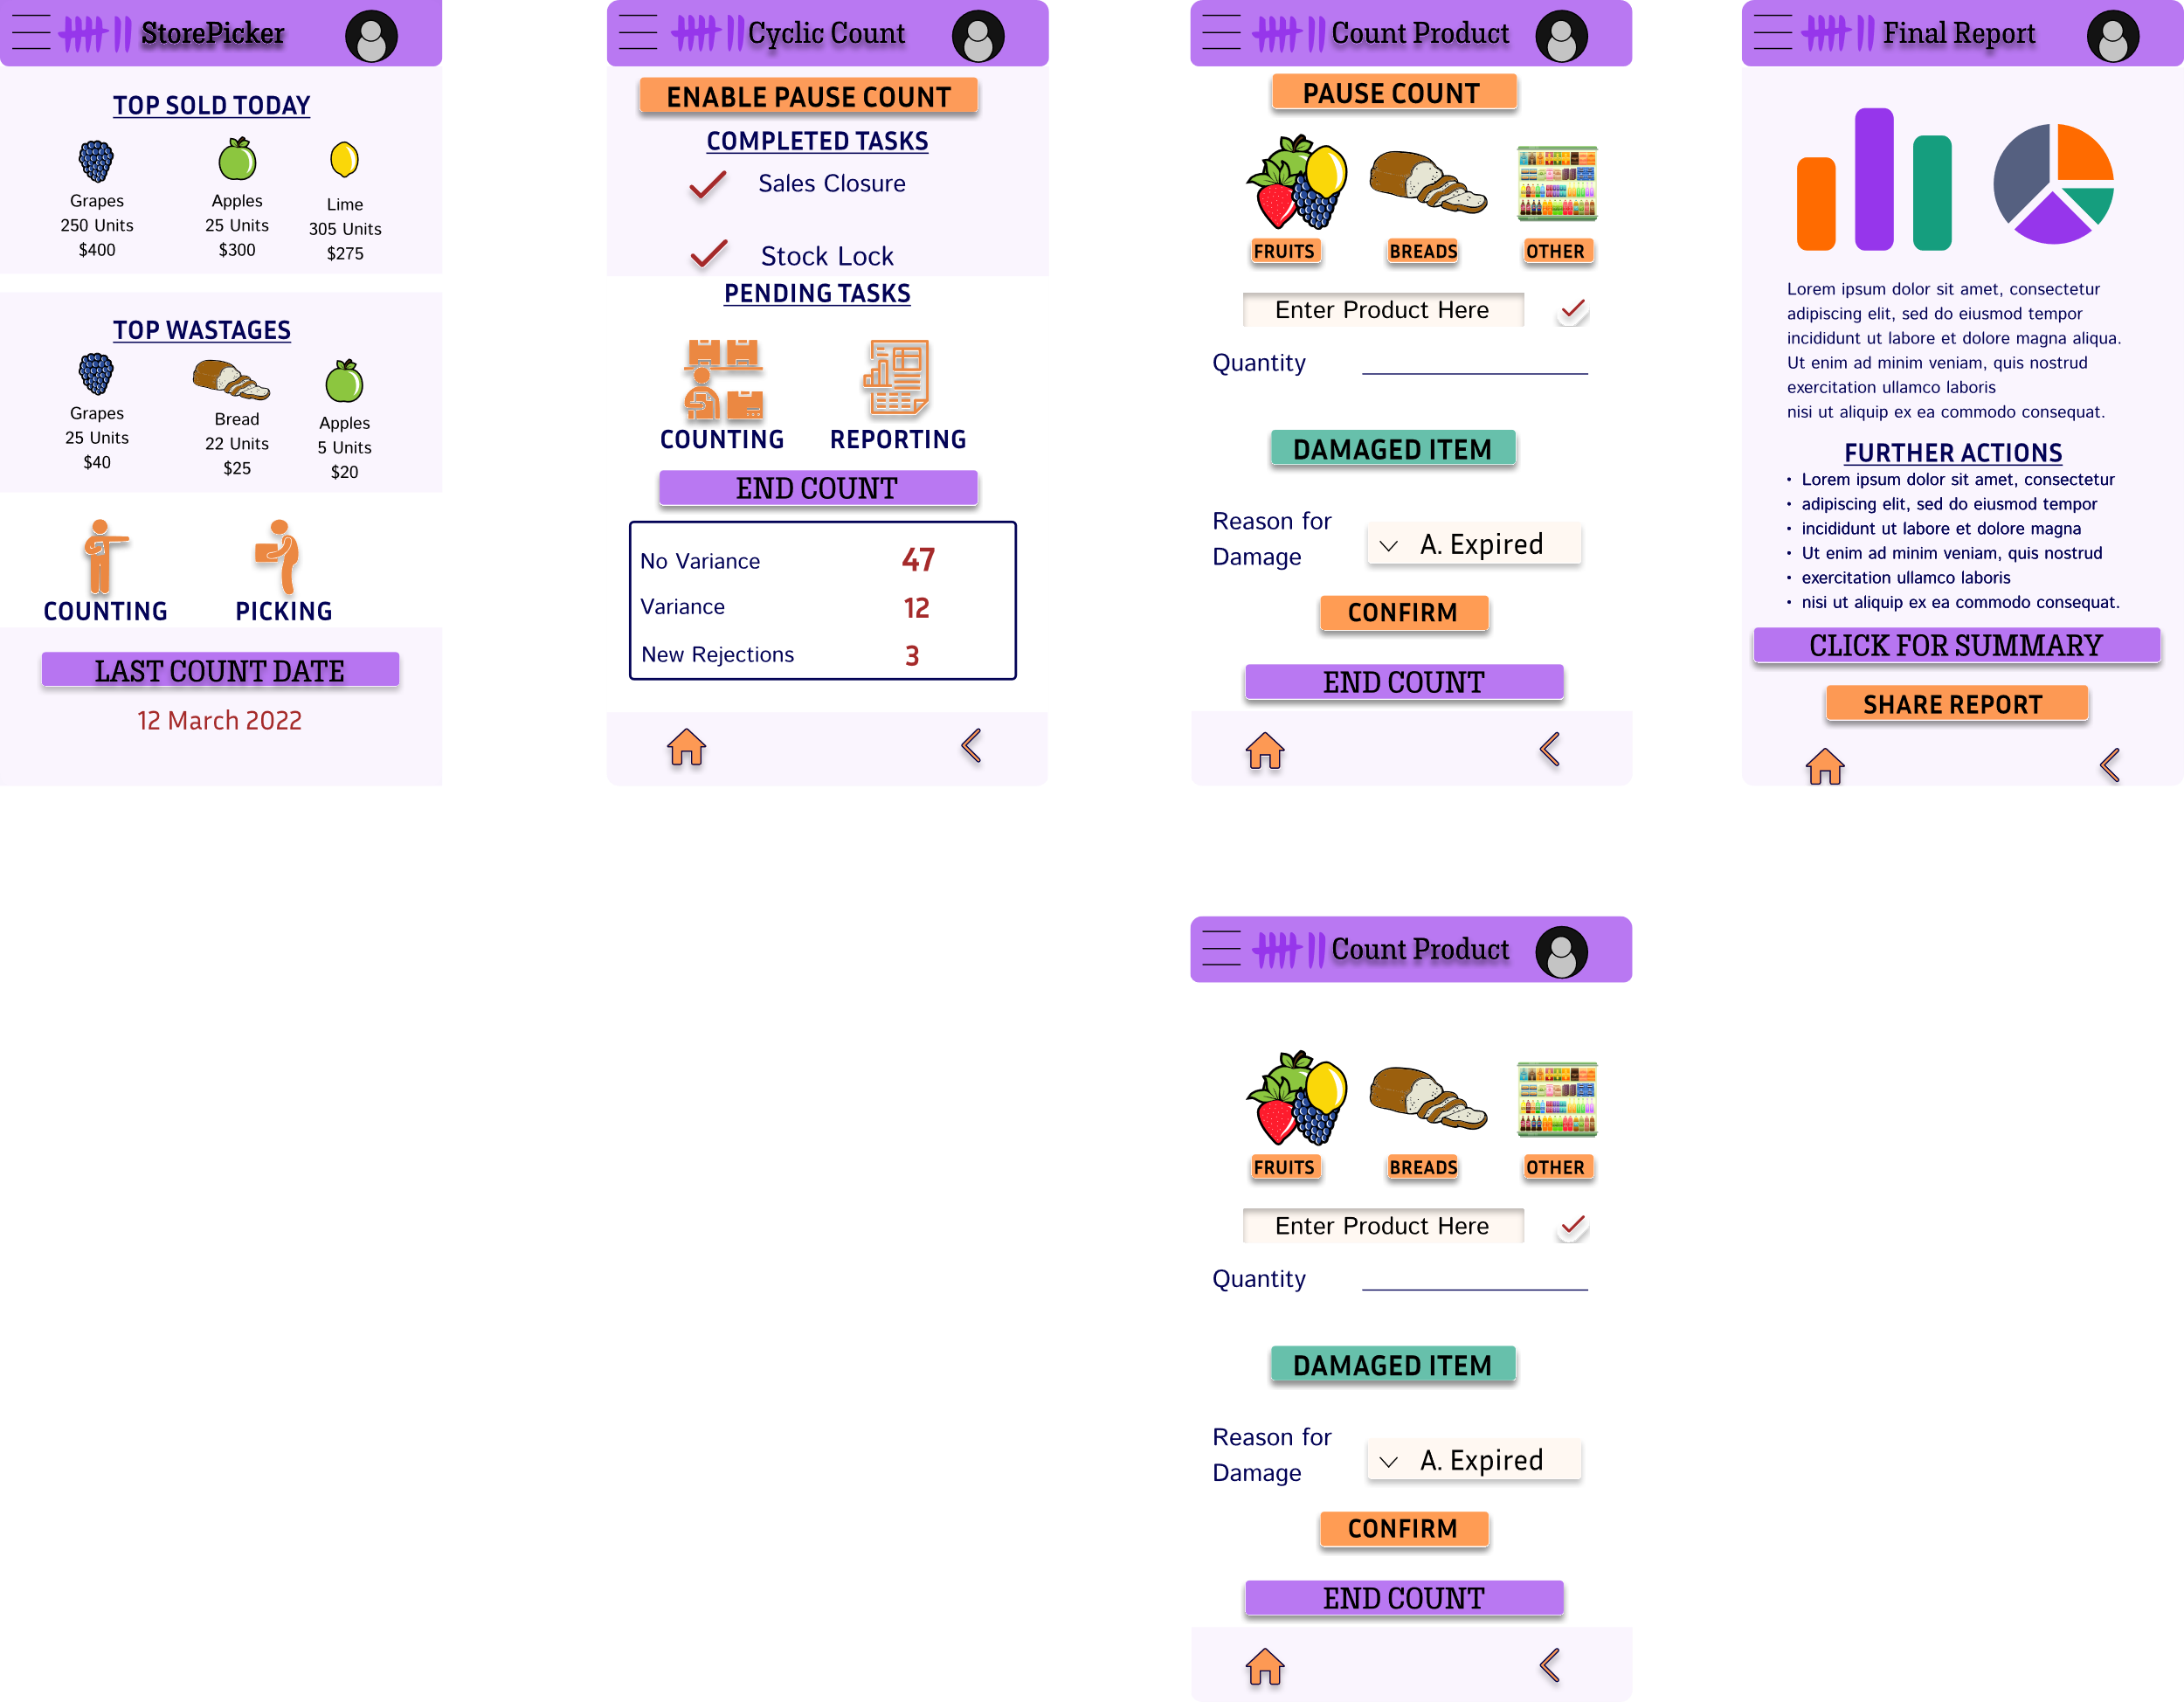
High-fidelity prototype
The final High-fidelity prototype presented makes the user flow more cleaner and more intuitive. It gives the user options to choose what he wants and what he wants to ignore.
View the StorePicker App
High-fidelity prototype

Slide 22
Accessibility considerations
1
2
3
Because the target users are not technologically up to date, the user flow includes visual cues like colour and placement and along with it, various levels of details in reports
The colour combination is chosen to ensure greater visibility and ensure that the end users will have a smoother journey even if they are visually challenged
A voice module is introduced to help cater the users whose knowledge of English is limited. Rather than going for a translation, we are going for voice commands to invoke the correct product.

Slide 23
Going forward
Takeaways
Next steps

Slide 24
Takeaways
Impact:
The app made users feel like StorePicker is really designed to suit their requirements.
One quote from peer feedback:
“This is exactly what I wanted! This is simple, easy to use and gives me enough information to do the day to day activities in the store”
What I learned:
While designing the StorePicker app, I learned that the first ideas for the app are only the beginning of the process. Usability studies and peer feedback influenced each iteration of the app’s designs.

Slide 25
Next steps
1
2
3
Conduct another round of usability studies to validate whether the pain points users experienced have been effectively addressed.
Conduct more user research to understand if there are other modules in the app which need to be made optional to make the user flow less cluttered.
Conduct more user research to determine any new areas of need.

Slide 26
Insert a few sentences summarizing the next steps you would take with this project and why. Feel free to organize next steps in a bullet point list.
Let’s connect!
Thank you for your time reviewing my work on the StorePicker app! If you’d like to see more or get in touch, my contact information is provided below.
Email: cbk124@gmail.com
Website: https://cbkwgl.webflow.io/work/storepicker

